Slide 1
Decision Tree – Entropy and Gini Index

Slide 2
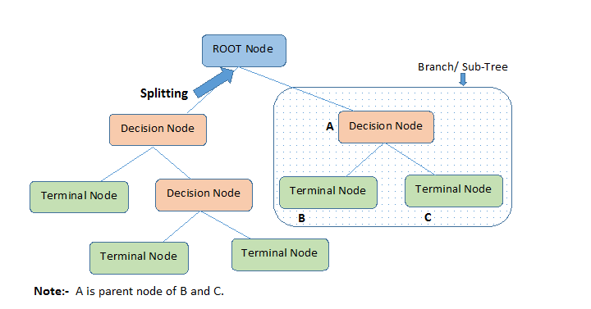
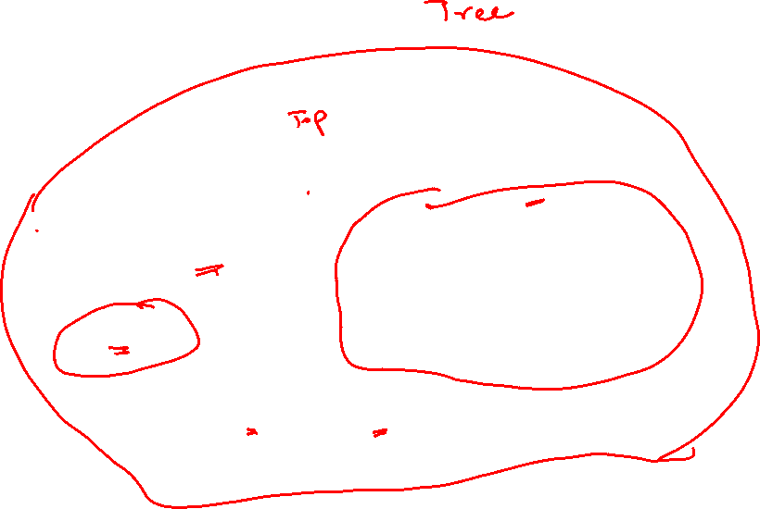

Slide 3
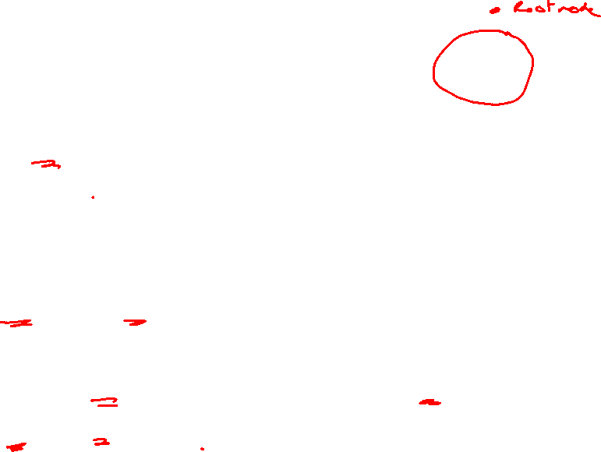
Definitions
Root Node: It represents entire population or sample and this further gets divided into two or more homogeneous sets.
Splitting: It is a process of dividing a node into two or more sub-nodes.
Decision Node: When a sub-node splits into further sub-nodes, then it is called decision node.
Leaf/ Terminal Node: Nodes with no children (no further split) is called Leaf or Terminal node.

Slide 4
Definitions
Pruning: When we reduce the size of decision trees by removing nodes (opposite of Splitting), the process is called pruning.
Branch / Sub-Tree: A sub section of decision tree is called branch or sub-tree.
Parent and Child Node: A node, which is divided into sub-nodes is called parent node of sub-nodes where as sub-nodes are the child of parent node.

Slide 5
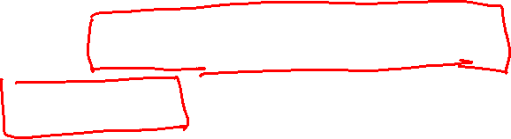
Types of Algorithms in Decision Tree
Algorithm used in decision trees:
ID3 – entropy, Information Gain
Gini Index

Slide 6
ID3- Entropy and Information Gain

Slide 7
ID3
ID3 (Iterative Dichotomiser 3)
The core algorithm for building decision trees is called ID3. Developed by J. R. Quinlan, this algorithm employs a top-down, greedy search through the space of possible branches with no backtracking. ID3 uses (Entropy and Information Gain) to construct a decision tree.

Slide 8
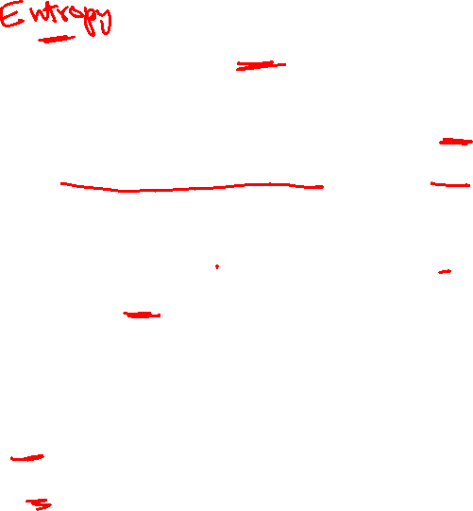
Information Gain
The information gain is the decrease in entropy after a dataset is split the basis of an attribute. Constructing a decision tree is all about finding attribute that returns the highest information gain. That is split at the attribute that has the highest information gain.
Information gain is calculated based on entropy.

Slide 9
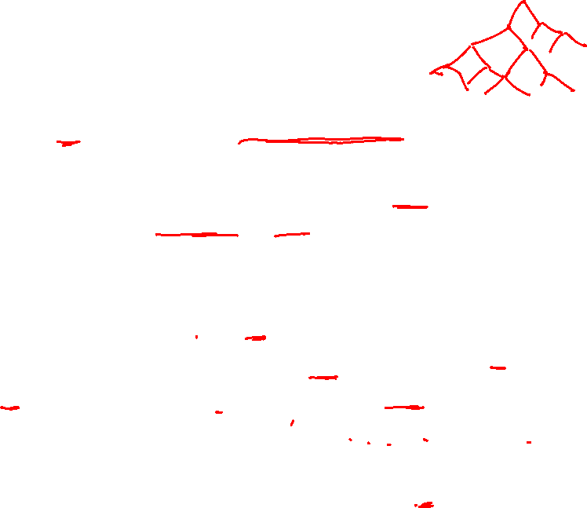
Entropy
Entropy is used for calculating Information gain.
Entropy : A decision tree is built top-down from a root node and involves partitioning the data into subsets that contain instances with similar values (homogeneous).
ID3 algorithm uses entropy to calculate the homogeneity of a sample.
Entropy is used measuring Impurity
If the sample is completely homogeneous the entropy is zero (If your data is matching- that means no impurity)
If the sample is equally divided then it has entropy of one. (contains equal divisions of different data). No matching data. Then Impurity is high so entropy is 1.

Slide 10
Example of Entropy
Let us say you have a bag of balls.
You grab one ball from the bag and put it on the table. How many ways can you arrange that ball? The answer: one way.
What if we grab two balls and ask the same question? Now there are more ways to arrange the two balls.
We keep doing this until all the balls are on the table. At this point, there are so many ways to arrange the bag of balls, you might not even be able to count the number of ways.
This situation is very much like entropy.
The higher the entropy (meaning the more ways the system can be arranged), the more the system is disordered.

Slide 11
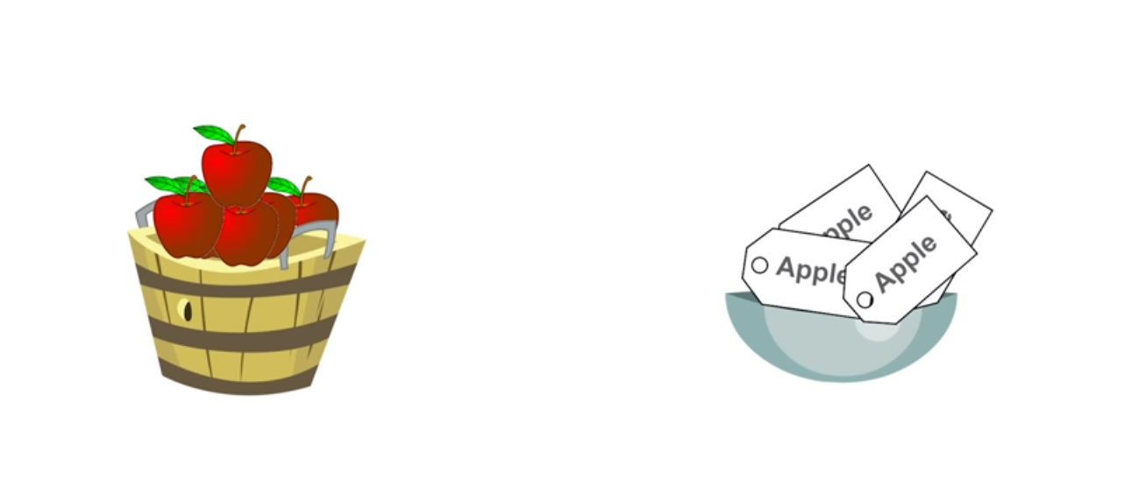
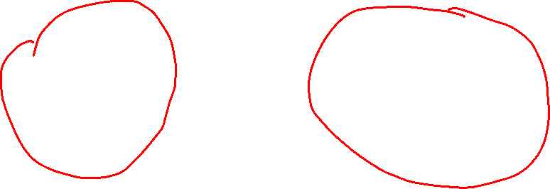
What is Impurity (in Entropy)

Slide 12
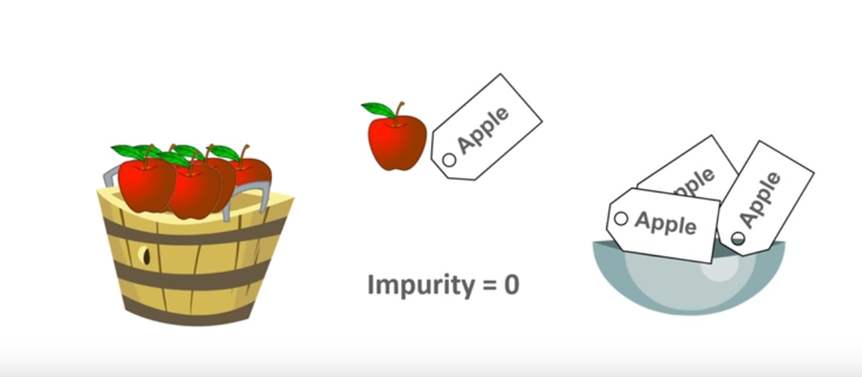
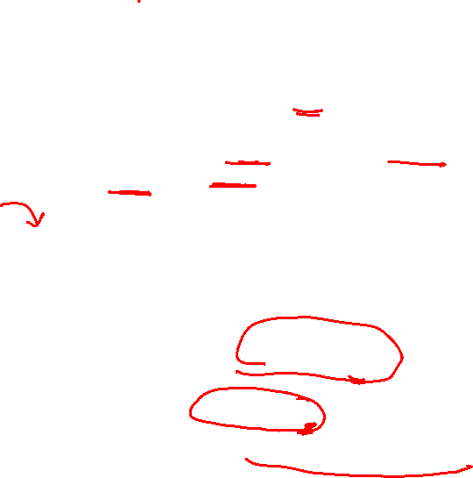
TASK: FRUITS should have matching Labels
Example: Apples should have the same label (Apples).
If you have to pick Apples and Labels from 2 baskets, you will always get matching labels. So the impurity is 0
Impurity is also the degree of Randomness. In the Basket the degree of Randomness is Less, so impurity is zero
Entropy is 0
Because Apple and Apple Label Match

Slide 13
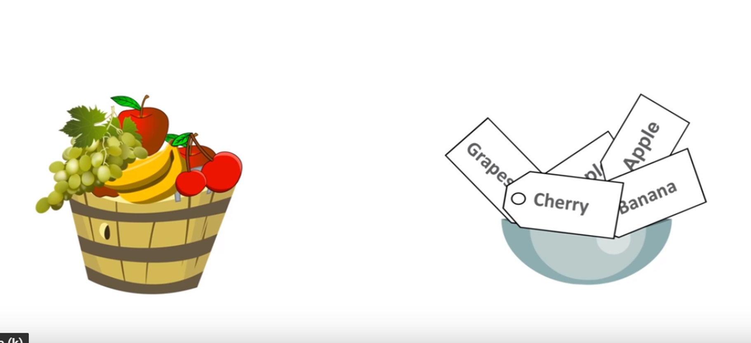
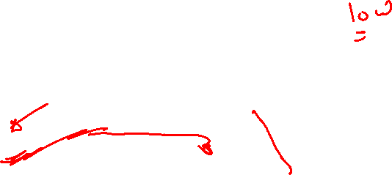
TASK: FRUITS should have matching Labels
Example: Apples should have the same label (Apples).
If you have 2 baskets with different fruits and different labels.
If you have to pick any Random FRUIT or LABEL , it may or may not match

Slide 14
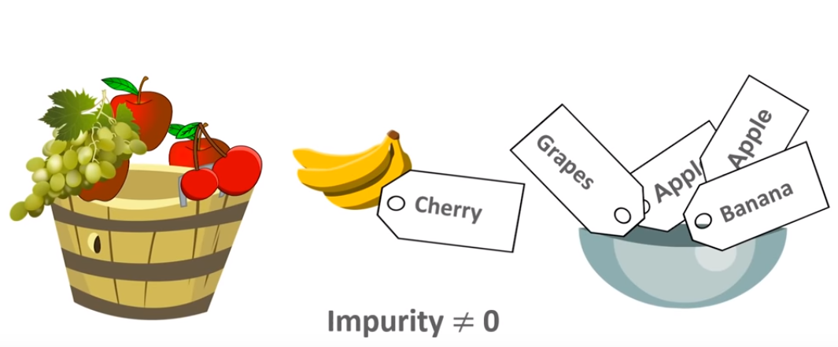
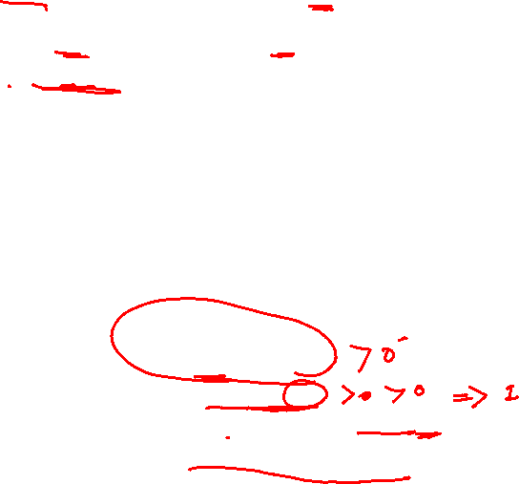
TASK: FRUITS should have matching Labels
Example: Apples should have the same label (Apples).
It may happen a Banana is match with a Cherry Label
So impurity is not equal to zero
Entropy not equal to 0
Entropy is more than 0 or closer to 1
Because Fruits and Label Do not Match

Slide 15
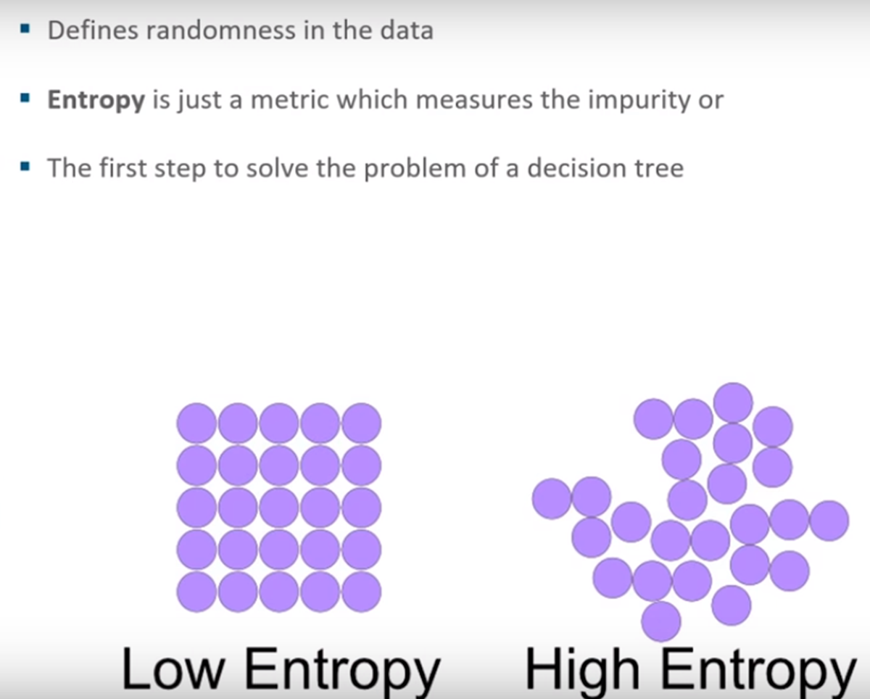
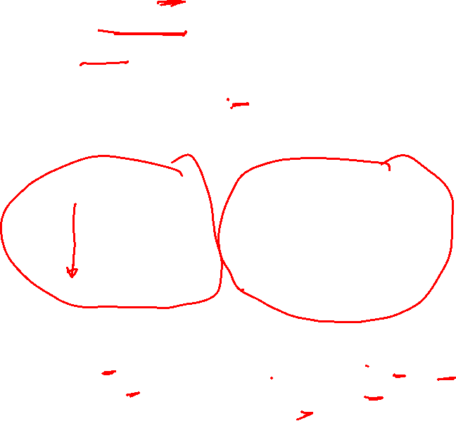
Entropy
Data Contains all Yes
Data Contains similar Types
More Pure
Data Contains mix of Yes and No
Data Contains Mix Types
Less Pure

Slide 16
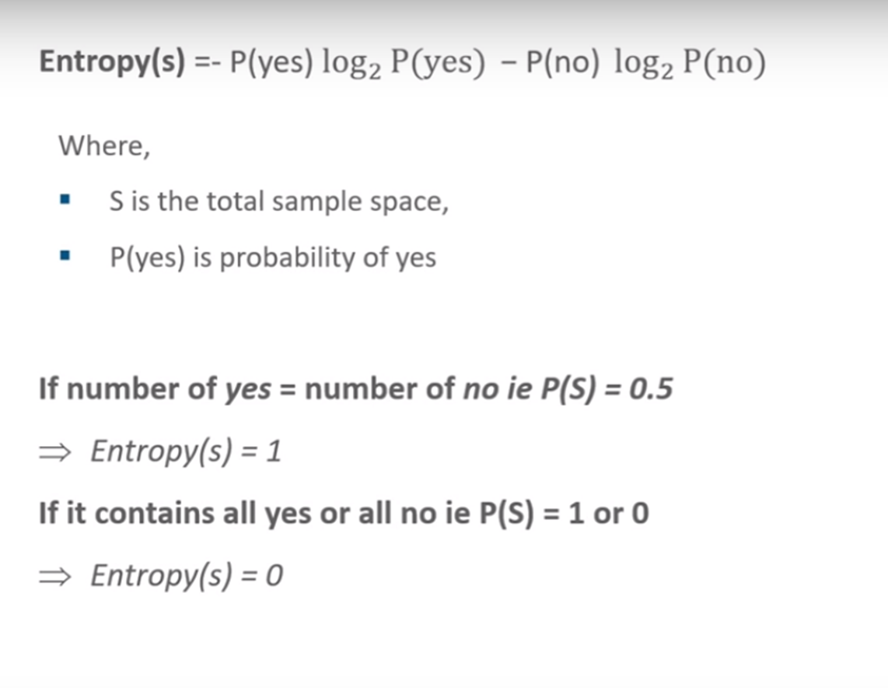
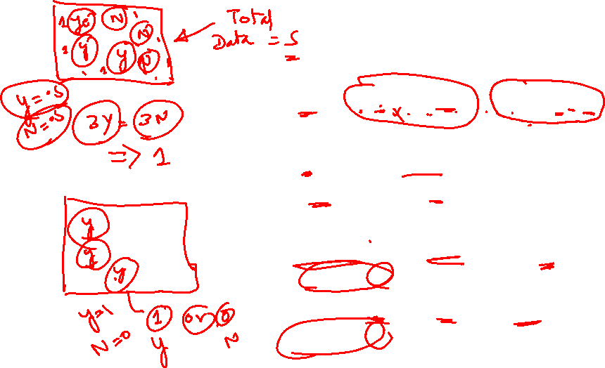
Entropy

Slide 17
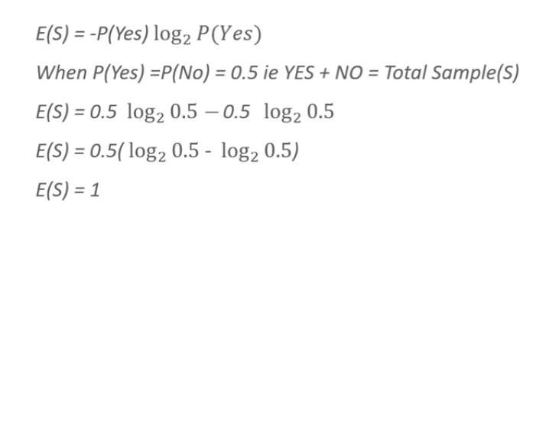
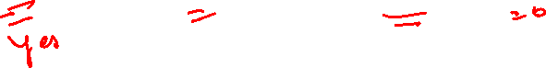
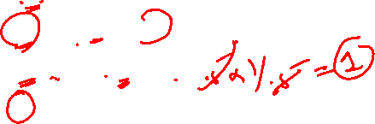
Half Yes, Half No, Entropy =1

Slide 18
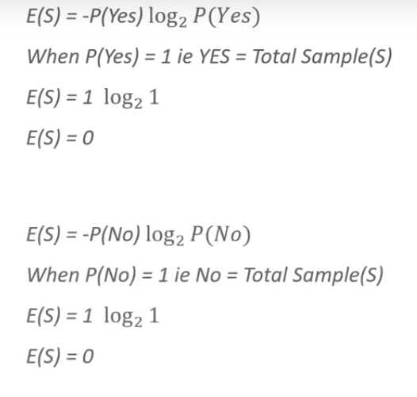
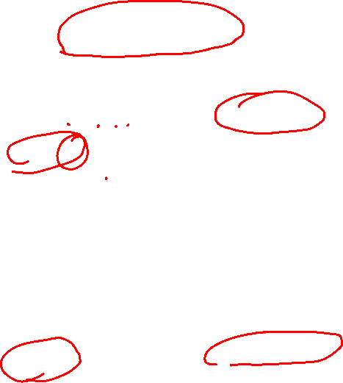
[Total Yes] or [Total No] Entropy] =0
Value of Log 1 is zero
Value of Log 1 is zero

Slide 19
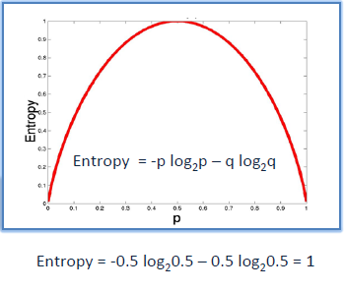
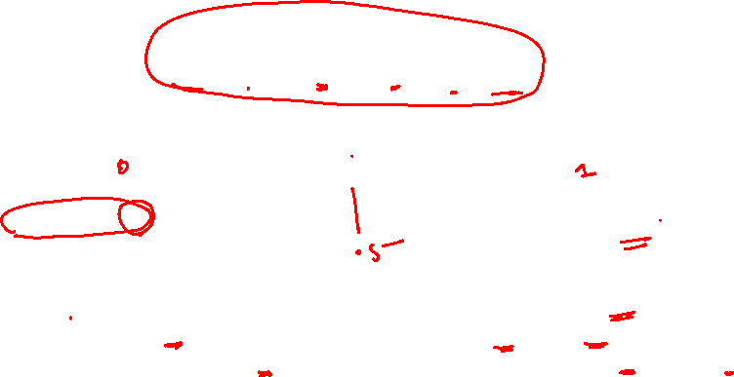
Entropy
Entropy = 0
Entropy = 1
Highly Pure
Highly Impure
Data is Pure, Randomness = 0
Data is of the Same Type, All Yes
Data is Impure, Randomness is high
Data is of the 2 Types, Half Yes + Half No

Slide 20
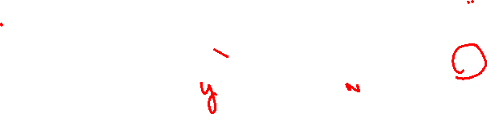
Entropy

Slide 21
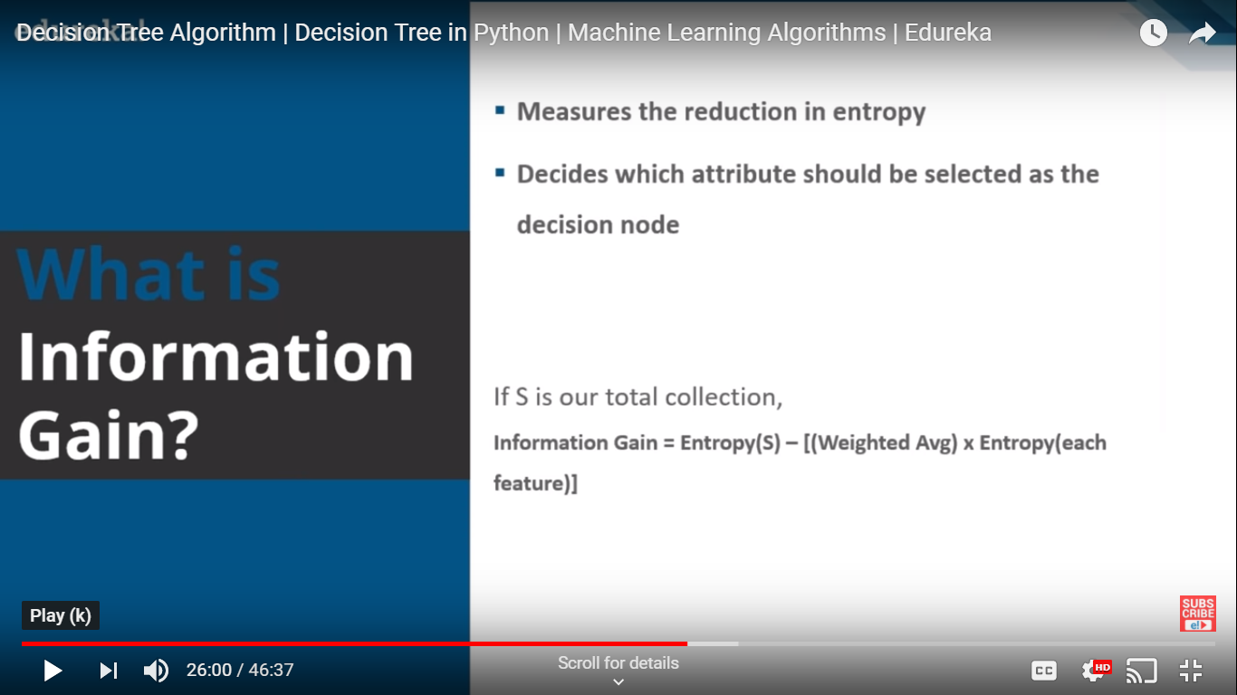
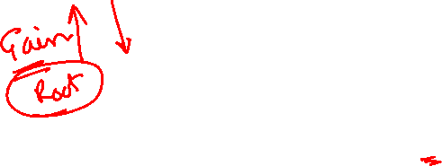
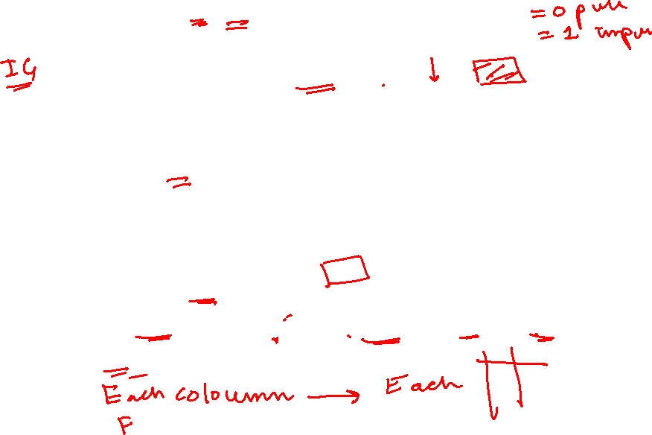
Information Gain

Slide 22
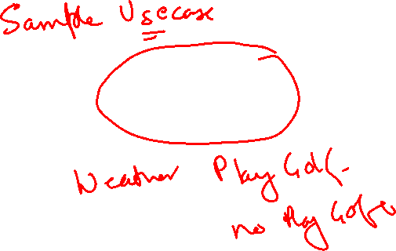
Decision Tree – Play Golf

Slide 23
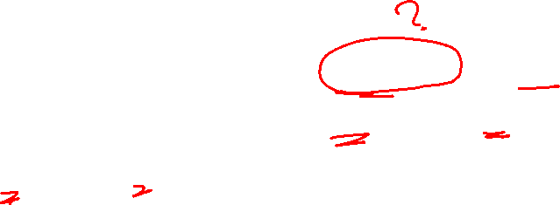
Decision Tree
To predict if a player will play golf that day based on the weather (Outlook, Temperature, Humidity, Windy).

Slide 24
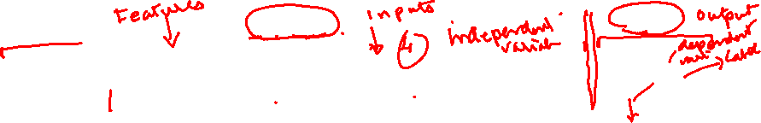
Predictors
Target
 | Outlook | Temp | Humid | Windy | Play
1 | sunny | hot | high | weak | no
2 | sunny | hot | high | strong | no
3 | overcast | hot | high | weak | yes
4 | rainy | mild | high | weak | yes
5 | rainy | cool | normal | weak | yes
6 | Rainy | cool | normal | strong | no
7 | Overcast | cool | normal | strong | yes
8 | sunny | mild | high | weak | no
9 | sunny | cool | normal | weak | yes
10 | rainy | mild | normal | weak | yes
11 | sunny | mild | normal | strong | yes
12 | overcast | mild | high | strong | yes
13 | overcast | hot | normal | weak | yes
14 | rainy | mild | high | strong | No

Slide 25
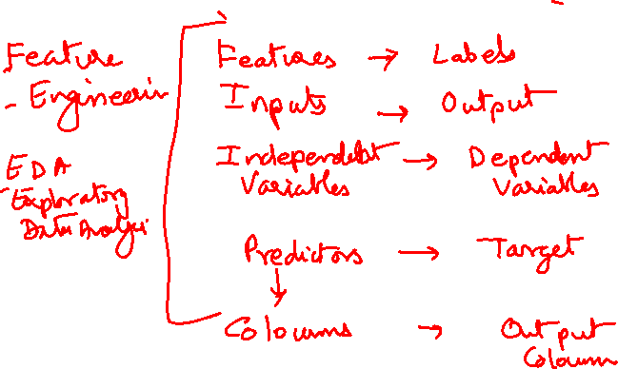

Slide 26
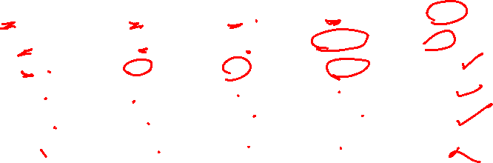
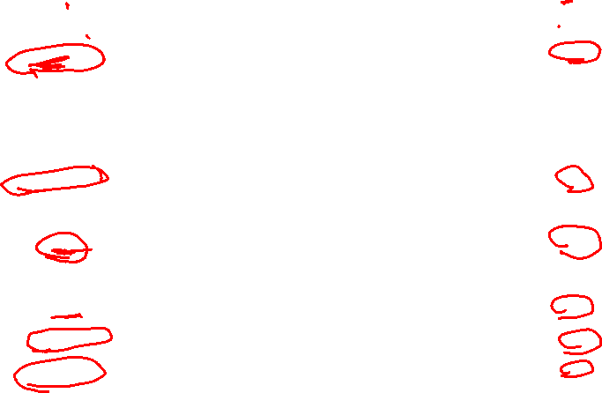
 | Outlook | Temp | Humid | Windy | Play
1 | sunny | hot | high | weak | no
2 | sunny | hot | high | strong | no
3 | overcast | hot | high | weak | yes
4 | rainy | mild | high | weak | yes
5 | rainy | cool | normal | weak | yes
6 | Rainy | cool | normal | strong | no
7 | Overcast | cool | normal | strong | yes
8 | sunny | mild | high | weak | no
9 | sunny | cool | normal | weak | yes
10 | rainy | mild | normal | weak | yes
11 | sunny | mild | normal | strong | yes
12 | overcast | mild | high | strong | yes
13 | overcast | hot | normal | weak | yes
14 | rainy | mild | high | strong | No

Slide 27
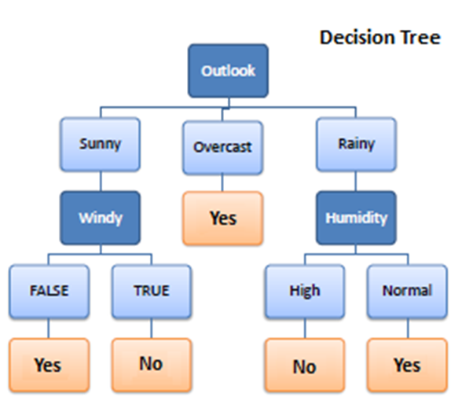
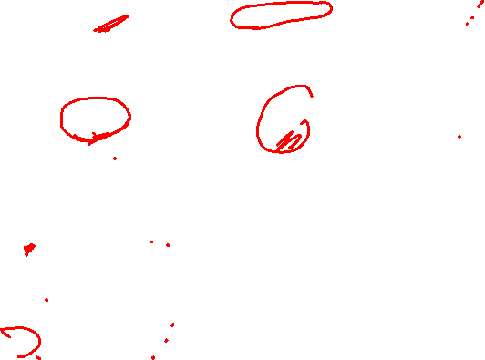
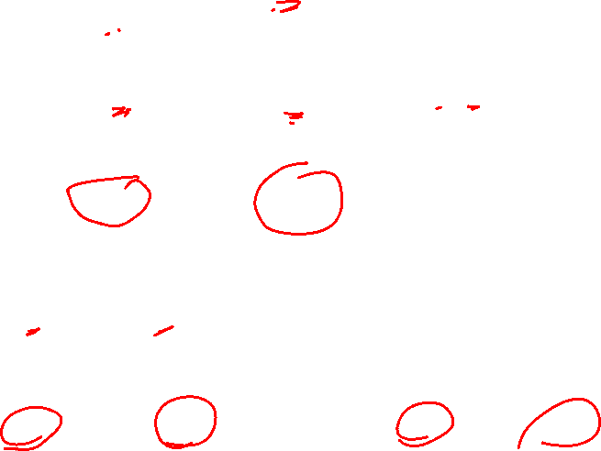
We need to build a Decision Tree, how to Select the Nodes?

Slide 28
Weather Data
 | Outlook | Temp | Humid | Windy | Play
1 | sunny | hot | high | weak | no
2 | sunny | hot | high | strong | no
3 | overcast | hot | high | weak | yes
4 | rainy | mild | high | weak | yes
5 | rainy | cool | normal | weak | yes
6 | Rainy | cool | normal | strong | no
7 | Overcast | cool | normal | strong | yes
8 | sunny | mild | high | weak | no
9 | sunny | cool | normal | weak | yes
10 | rainy | mild | normal | weak | yes
11 | sunny | mild | normal | strong | yes
12 | overcast | mild | high | strong | yes
13 | overcast | hot | normal | weak | yes
14 | rainy | mild | high | strong | No

Slide 29
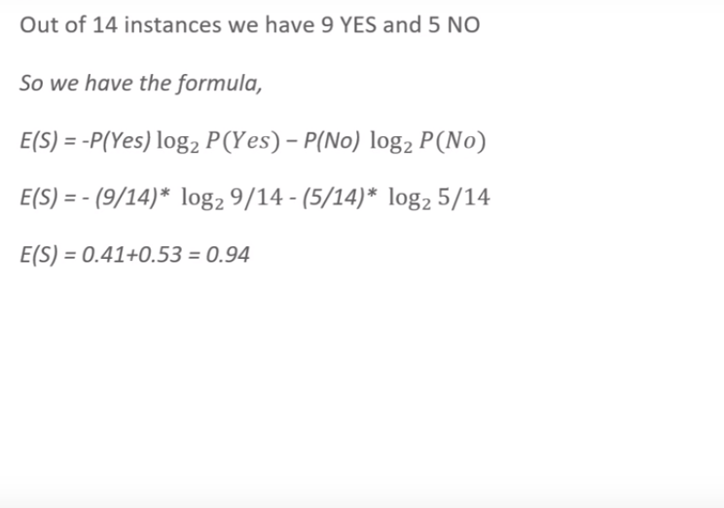
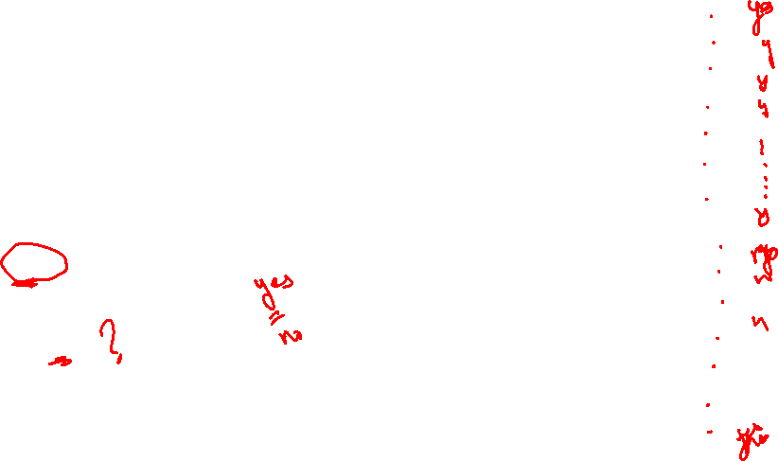
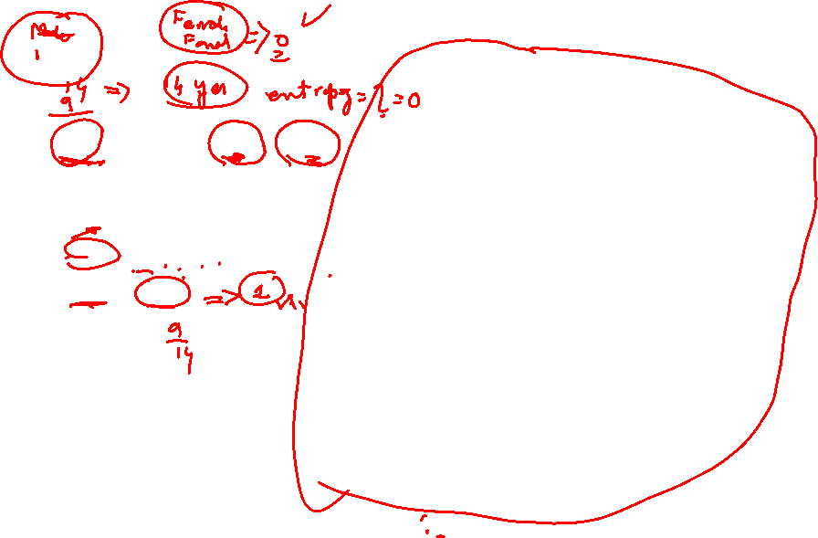
Compute Entropy Of Total DataSet Rows = 14
 | Outlook | Temp | Humid | Windy | Play
1 | sunny | hot | high | weak | no
2 | sunny | hot | high | strong | no
3 | overcast | hot | high | weak | yes
4 | rainy | mild | high | weak | yes
5 | rainy | cool | normal | weak | yes
6 | Rainy | cool | normal | strong | no
7 | Overcast | cool | normal | strong | yes
8 | sunny | mild | high | weak | no
9 | sunny | cool | normal | weak | yes
10 | rainy | mild | normal | weak | yes
11 | sunny | mild | normal | strong | yes
12 | overcast | mild | high | strong | yes
13 | overcast | hot | normal | weak | yes
14 | rainy | mild | high | strong | No
E(S) = 0.94
Entropy of the entire datset = 0.94

Slide 30
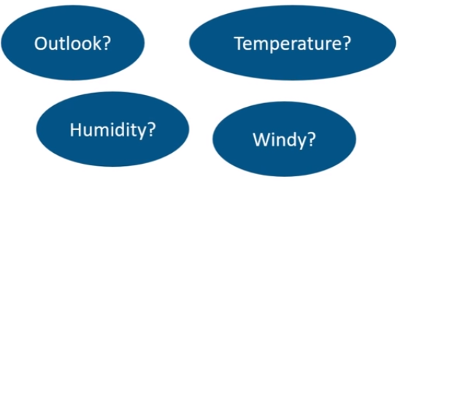
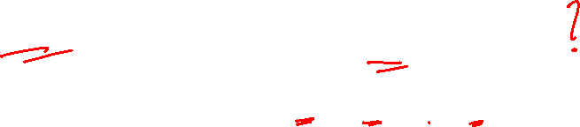
Which Node to select as Root Node
 | Outlook | Temp | Humid | Windy | Play
1 | sunny | hot | high | weak | no
2 | sunny | hot | high | strong | no
3 | overcast | hot | high | weak | yes
4 | rainy | mild | high | weak | yes
5 | rainy | cool | normal | weak | yes
6 | Rainy | cool | normal | strong | no
7 | Overcast | cool | normal | strong | yes
8 | sunny | mild | high | weak | no
9 | sunny | cool | normal | weak | yes
10 | rainy | mild | normal | weak | yes
11 | sunny | mild | normal | strong | yes
12 | overcast | mild | high | strong | yes
13 | overcast | hot | normal | weak | yes
14 | rainy | mild | high | strong | No

Slide 31
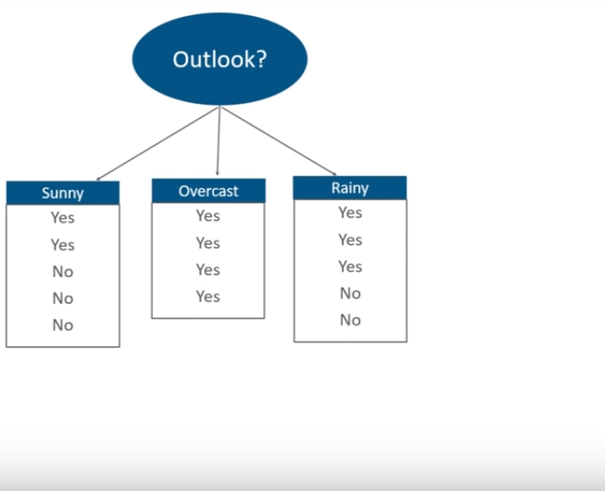
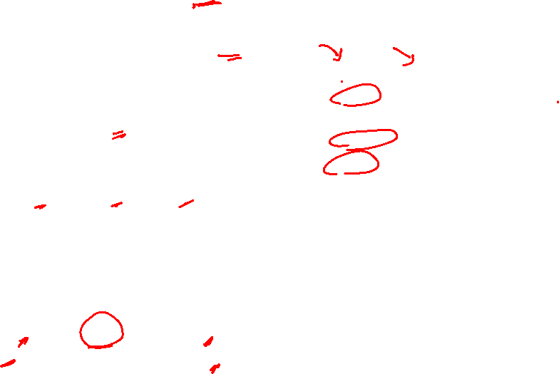
Calculated Entropy and Information Gain for Each Node
 | Outlook | Temp | Humid | Windy | Play
1 | sunny | hot | high | weak | no
2 | sunny | hot | high | strong | no
3 | overcast | hot | high | weak | yes
4 | rainy | mild | high | weak | yes
5 | rainy | cool | normal | weak | yes
6 | Rainy | cool | normal | strong | no
7 | Overcast | cool | normal | strong | yes
8 | sunny | mild | high | weak | no
9 | sunny | cool | normal | weak | yes
10 | rainy | mild | normal | weak | yes
11 | sunny | mild | normal | strong | yes
12 | overcast | mild | high | strong | yes
13 | overcast | hot | normal | weak | yes
14 | rainy | mild | high | strong | No
Start with
Y=2
N=3
Y=4
Y=3
N=2
Play

Slide 32
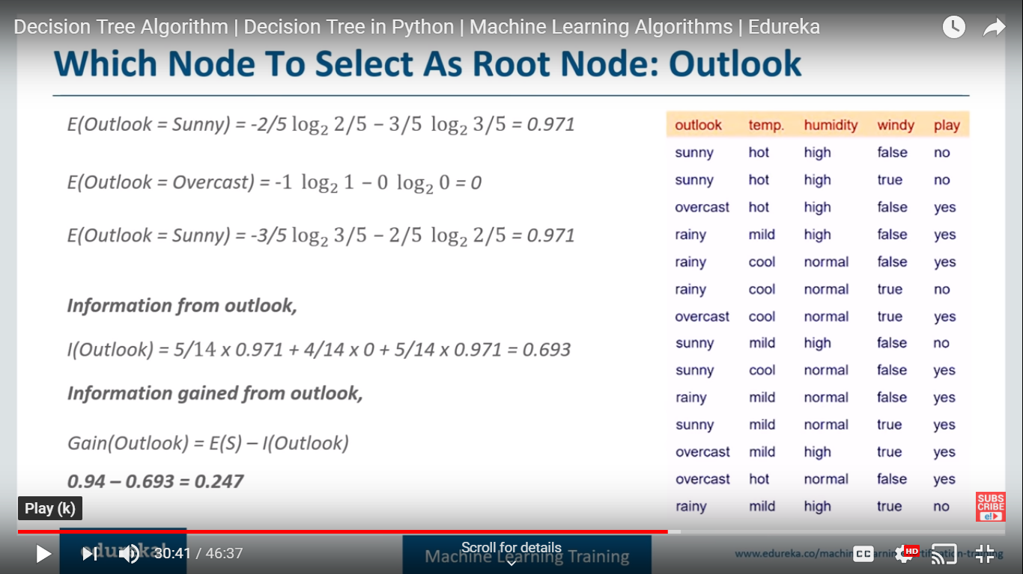
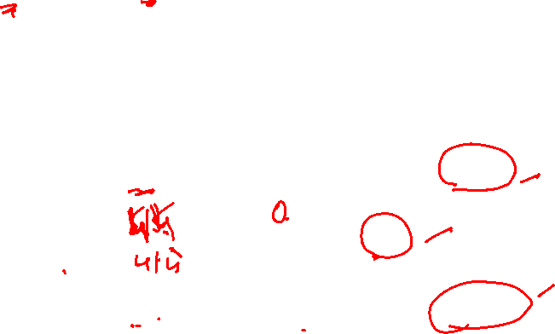
Which Node to select as Root Node: Outlook
Let us Consider Outlook as Node
0
Rainy

Slide 33
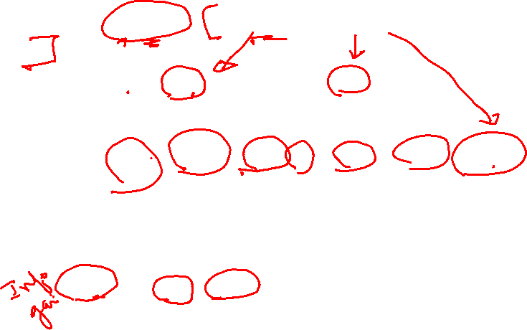
Information Gain for : Outlook
Weighted Avg (Sunny) = 5/14 , Entropy(Sunny) = .971
Sunny
Overcast
Rainy
0.247 = 0.94 – 0.693
Entropy of the datset

Slide 34
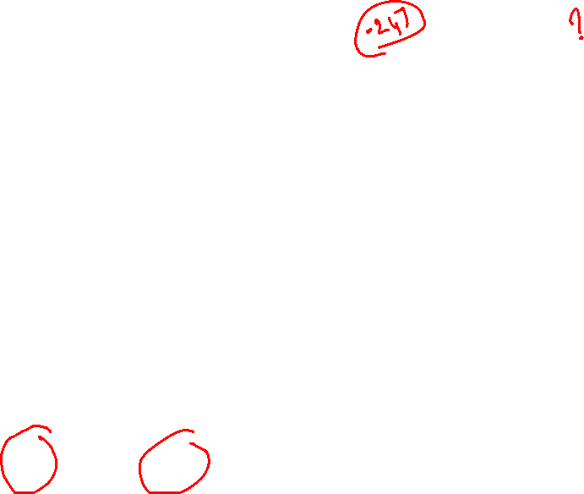
Which node to select as Root Node ? Windy
windy
 | Outlook | Temp | Humid | Windy | Play
1 | sunny | hot | high | weak | no
2 | sunny | hot | high | strong | no
3 | overcast | hot | high | weak | yes
4 | rainy | mild | high | weak | yes
5 | rainy | cool | normal | weak | yes
6 | Rainy | cool | normal | strong | no
7 | Overcast | cool | normal | strong | yes
8 | sunny | mild | high | weak | no
9 | sunny | cool | normal | weak | yes
10 | rainy | mild | normal | weak | yes
11 | sunny | mild | normal | strong | yes
12 | overcast | mild | high | strong | yes
13 | overcast | hot | normal | weak | yes
14 | rainy | mild | high | strong | No
Play
Yes=3
No=3
Yes=6
No=2

Slide 35
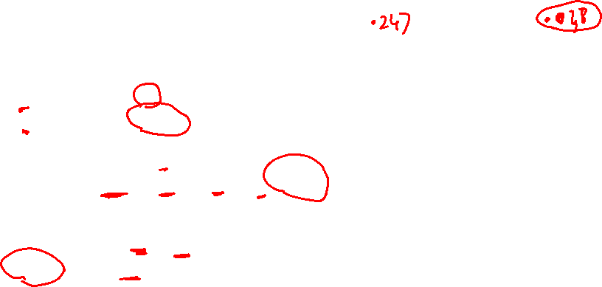
Information Gain for : Windy
 | Outlook | Temp | Humid | Windy | Play
1 | sunny | hot | high | weak | no
2 | sunny | hot | high | strong | no
3 | overcast | hot | high | weak | yes
4 | rainy | mild | high | weak | yes
5 | rainy | cool | normal | weak | yes
6 | Rainy | cool | normal | strong | no
7 | Overcast | cool | normal | strong | yes
8 | sunny | mild | high | weak | no
9 | sunny | cool | normal | weak | yes
10 | rainy | mild | normal | weak | yes
11 | sunny | mild | normal | strong | yes
12 | overcast | mild | high | strong | yes
13 | overcast | hot | normal | weak | yes
14 | rainy | mild | high | strong | No
E(Windy=Weak)=1
E(Windy=False)=0.811
Information from Windy:
I(Windy) = 8/14 x 0.811 + 6/14 x 1 = 0.892
Information Gain from Windy:
Gain(Windy) = E(S) - I(Windy)
0.048 = 0.94 -0.892

Slide 36


Calculate the Info Gain for all the nodes
 | Outlook | Temp | Humid | Windy | Play
1 | sunny | hot | high | weak | no
2 | sunny | hot | high | strong | no
3 | overcast | hot | high | weak | yes
4 | rainy | mild | high | weak | yes
5 | rainy | cool | normal | weak | yes
6 | Rainy | cool | normal | strong | no
7 | Overcast | cool | normal | strong | yes
8 | sunny | mild | high | weak | no
9 | sunny | cool | normal | weak | yes
10 | rainy | mild | normal | weak | yes
11 | sunny | mild | normal | strong | yes
12 | overcast | mild | high | strong | yes
13 | overcast | hot | normal | weak | yes
14 | rainy | mild | high | strong | No
Entropy of Total dataset : .940
Outlook has maximum gain so it is our root node

Slide 37

Select the Node with highest Info Gain: Outlook
 | Outlook | Temp | Humid | Windy | Play
1 | sunny | hot | high | weak | no
2 | sunny | hot | high | strong | no
3 | overcast | hot | high | weak | yes
4 | rainy | mild | high | weak | yes
5 | rainy | cool | normal | weak | yes
6 | Rainy | cool | normal | strong | no
7 | Overcast | cool | normal | strong | yes
8 | sunny | mild | high | weak | no
9 | sunny | cool | normal | weak | yes
10 | rainy | mild | normal | weak | yes
11 | sunny | mild | normal | strong | yes
12 | overcast | mild | high | strong | yes
13 | overcast | hot | normal | weak | yes
14 | rainy | mild | high | strong | No
Entropy of Total dataset : .940
Outlook has maximum gain so it is our root node

Slide 38


Select the node that gives more accurate answers

Slide 41


Slide 42
Decision Tree using Gini Index

Slide 43


Slide 44
Gini is intended for continuous attributes, and Entropy for attributes that occur in classes.
Gini will tend to find the largest class, and entropy tends to find groups of classes that make up ~50% of the data.
Gini to minimize misclassification.
Entropy for exploratory analysis.
Some studies show this doesn’t matter – these differ less than 2% of the time.
Entropy may be a little slower to compute.

Slide 45
Gini Index

Slide 46
 | Outlook | Temp | Humid | Windy | Play
1 | sunny | hot | high | weak | no
2 | sunny | hot | high | strong | no
3 | overcast | hot | high | weak | yes
4 | rainy | mild | high | weak | yes
5 | rainy | cool | normal | weak | yes
6 | Rainy | cool | normal | strong | no
7 | Overcast | cool | normal | strong | yes
8 | sunny | mild | high | weak | no
9 | sunny | cool | normal | weak | yes
10 | rainy | mild | normal | weak | yes
11 | sunny | mild | normal | strong | yes
12 | overcast | mild | high | strong | yes
13 | overcast | hot | normal | weak | yes
14 | rainy | mild | high | strong | No

Slide 47
Gini Index
Gini index says, if we select two items from a population at random then they must be of same class and probability for this is 1, if population is pure.
It works with categorical target variable “Success” or “Failure”.
It performs only Binary splits
Higher the value of Gini higher the homogeneity.
CART (Classification and Regression Tree) uses Gini method to create binary splits.

Slide 48
Calucate Gini for a split
Calculate Gini for sub-nodes, using formula sum of square of probability for success and failure (p²+q²).
Calculate Gini for split using weighted Gini score of each node of that split

Slide 49



Gini index measures the impurity of a data partition K, formula for Gini Index can be written down as:
Where n is the number of classes, and P_{i} is the probability that an observation in K belongs to the class.
Gini Index assumes a binary split for each of the attribute in S, let say T₁ & T_{2.} The Gini index of K given this partitioning is given by:

Slide 50

Calculate Gini Index
So as the first step we will find the root node of our decision tree. For that Calculate the gini index of the class variable (Play)
Gini(S) = 1 - [(9/14)² + (5/14)²] = 0.4591

Slide 51

Gini Gain
we will calculate gini gain. For that first, we will find the average weighted gini impurity of Outlook, Temperature, Humidity and Windy.

Slide 52


Gini Gain - Outlook
Gini(S, outlook) = (5/14)gini(3,2) + (4/14)*gini(4,0)+ (5/14)*gini(2,3) = (5/14)(1 - (3/5)² - (2/5)²) + (4/14)*0 + (5/14)(1 - (2/5)² - (3/5)²)= 0.171+0+0.171 = 0.342
Gini gain (S, outlook) = 0.459 - 0.342 = 0.117
Gini Index : Play

Slide 53

Gini Gain – For all Predictors
Gini gain (S, outlook) = 0.459 - 0.342 = 0.117
Gini gain(S, Temperature) = 0.459 - 0.4405 = 0.0185
Gini gain(S, Humidity) = 0.459 - 0.3674 = 0.0916
Gini gain(S, windy) = 0.459 - 0.4286 = 0.0304
Choose one that having higher gini gain.
Gini gain is higher for outlook .So we can choose it as our root node.

Slide 54

Split on Which Column?
Above, you can see that Gini score for Split on Outlook (0.117) is higher than Split on other Classes(Columns) hence, the node split will take place on Outlook

Slide 55
Gini Vs Entropy

Slide 56

Gini Vs Entropy
The Gini Index is calculated by subtracting the sum of the squared probabilities of each class from one. It favours larger partitions.
Information Gain multiplies the probability of the class times the log (base=2) of that class probability. Information Gain favors smaller partitions with many distinct values.
Ultimately, you have to experiment with your data and the splitting criterion.

Slide 57
End

Slide 58


Slide 61
Random Forest

Slide 62

Definitions
The Random Forest is a model made up of many decision trees. Rather than just simply averaging the prediction of trees (which we could call a “forest”)
This model uses two key concepts that gives it the name random:
Random sampling of training data points when building trees
Random subsets of features considered when splitting nodes

Slide 63

Random Forest
It is a Ensemble methods, which combines several decision trees to produce better predictive performance than utilizing a single decision tree
The random forest combines hundreds or thousands of decision trees, trains each one on a slightly different set of the observations, splitting nodes in each tree considering a limited number of the features.
The final predictions of the random forest are made by averaging the predictions of each individual tree.

Slide 64

Random Forest
The first step in Random Forest is that it will divide the data into smaller subsets
Every subset need not be distinct, some may overlap
For each subset a decision tree is made

Slide 65

Random sampling of training observations
Each tree in a random forest learns from a random sample of the data points
The samples are drawn with replacement, known as bootstrapping, which means that some samples will be used multiple times in a single tree
At test time, predictions are made by averaging the predictions of each decision tree
This procedure of training each individual learner on different bootstrapped subsets of the data and then averaging the predictions is known as bagging, short for bootstrap aggregating.

Slide 66
 | Outlook | Temp | Humid | Windy | Play
1 | sunny | hot | high | weak | no
2 | sunny | hot | high | strong | no
3 | overcast | hot | high | weak | yes
4 | rainy | mild | high | weak | yes
5 | rainy | cool | normal | weak | yes
6 | Rainy | cool | normal | strong | no
7 | Overcast | cool | normal | strong | yes
8 | sunny | mild | high | weak | no
9 | sunny | cool | normal | weak | yes
10 | rainy | mild | normal | weak | yes
11 | sunny | mild | normal | strong | yes
12 | overcast | mild | high | strong | yes
13 | overcast | hot | normal | weak | yes
14 | rainy | mild | high | strong | No

Slide 67


Tree 1

Slide 68


Tree 2

Slide 69

Tree 3

Slide 70


Tree n

Slide 71


Tally: four 1s and three 0s
Prediction = 1
Notes:
The reason for this wonderful effect is that the trees protect each other from their individual errors

Slide 72

Building many decision trees results in a forest
First, it uses the Bagging (Bootstrap Aggregating) algorithm to create random samples. Given a data set D1 (n rows and p columns), it creates a new dataset (D2) by sampling n cases at random with replacement from the original data. About 1/3 of the rows from D1 are left out, known as Out of Bag(OOB) samples.
Then, the model trains on D2. OOB sample is used to determine unbiased estimate of the error.
Out of p columns, P << p columns are selected at each node in the data set. The P columns are selected at random. Usually, the default choice of P is p/3 for regression tree and P is sqrt(p) for classification tree.

Slide 73
Building many decision trees results in a forest
Unlike a tree, no pruning takes place in random forest; i.e, each tree is grown fully. In decision trees, pruning is a method to avoid overfitting. Pruning means selecting a subtree that leads to the lowest test errror rate. We can use cross validation to determine the test error rate of a subtree.
Several trees are grown and the final prediction is obtained by averaging or voting.
Each tree is grown on a different sample of original data. Since random forest has the feature to calculate OOB error internally, cross validation doesn't make much sense in random forest.

Slide 74

Advantages and Disadvantages of Random Forest
Advantages Disadvantages
It is robust to correlated predictors.
It is used to solve both regression and classification problems.
It can be also used to solve unsupervised ML problems.
It can handle thousands of input variables without variable selection.
It can be used as a feature selection tool using its variable importance plot.
It takes care of missing data internally in an effective manner.
The Random Forest model is difficult to interpret.
It tends to return erratic predictions for observations out of range of training data. For example, the training data contains two variable x and y. The range of x variable is 30 to 70. If the test data has x = 200, random forest would give an unreliable prediction.
It can take longer than expected time to computer a large number of trees.

Slide 75


Random Forest algorithm Application
Notes:
just a few applications of using Random Forest algorithm: Banking, Medicine, Stock Market and E-commerce

Slide 76
Random Forest algorithm Application
In banking sector, Random Forest algorithm is used to find loyal customers, which means customers who can take out plenty of loans and pay interest to the bank properly, and fraud customers, which means customers who have bad records like failure to pay back a loan on time or have dangerous actions.
In medicine, Random Forest algorithm can be used to both identify the correct combination of components in medicine, and to identify diseases by analyzing the patient’s medical records.
In the stock market, Random Forest algorithm can be used to identify a stock’s behavior and the expected loss or profit.
In e-commerce, Random Forest algorithm can be used for predicting whether the customer will like the recommend products, based on the experience of similar customers.

Slide 77
End

